Slide 1
Bank Marketing Campaign

Slide 2
BRIEF OVERVIEW OF THE PROJECT
Objective is to predict whether customers will subscribe to a product or not.
Data set contains 4522 rows, 17 columns, and no missing values.
Insights were gathered using exploratory data analysis.
Developed models using four algorithms(decision tree, KNN, logistic regression and random forest).
Evaluation of the models is done with the following metrics; accuracy, precision, recall and confusion matrix.

Slide 3
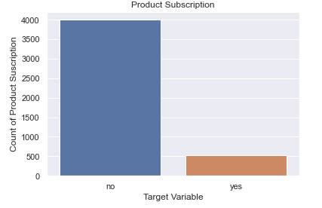
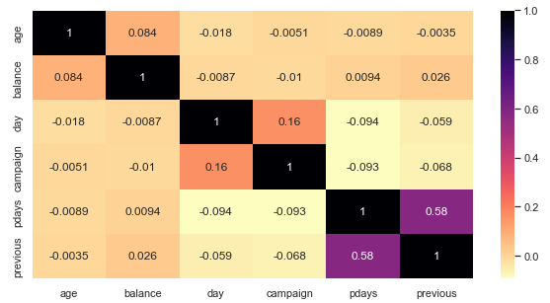
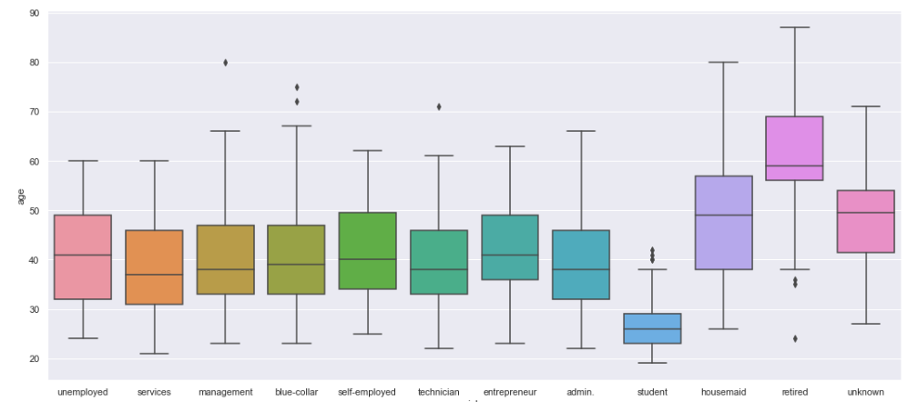
EDA INSIGHTS

Slide 4
METHODOLOGY
Remove features that have no effect on the target variable.
One-Hot Encoding (the process of converting categorical data to numeric data to train the model).
Created the final data set for training and testing.
Partitioned the data into training and testing sets.
I used a 70/30 split: 70% train data, 30% test data.
To build models, four algorithms (decision tree, K-Nearest Neighbor, Logistic Regression, and Random Forest) were used.
The models were evaluated using an accuracy, precision, recall, and confusion matrix.

Slide 5
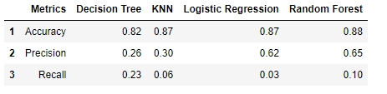
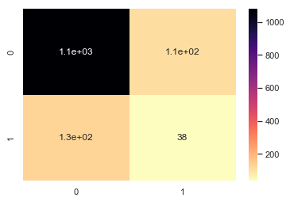
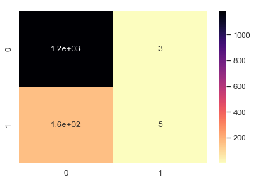
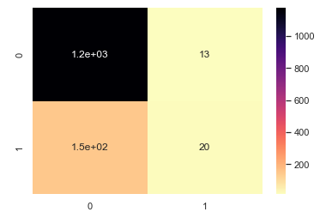
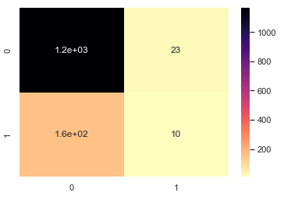
EVALUATION OF MODELS
The table above shows that random forest is the best model to be use for prediction because of it’s high accuracy and precision.
The confusion matrix for the four models is shown below;

